Slide 1
CS 476 – Programming Language Design
William Mansky

Slide 2

Notes:
Poll Title: Do not modify the notes in this section to avoid tampering with the Poll Everywhere activity.
More info at polleverywhere.com/support
Questions
https://www.polleverywhere.com/discourses/SRzwhp4zztmGWgIgz520A

Slide 3
Language #1: Expressions
Simple arithmetic and boolean operations
Every term computes to a value, either int or bool
Arithmetic operators: plus, minus, times
Boolean operators: and, or, not, comparison, if-then-else
3 + 5 * 9 should compute to 48
if 1 = 0 or 1 = 1 then 2 else 4 should compute to 2

Slide 4
Expressions: Syntax
E ::= <#>
| E + E | E – E | E * E
| <bool>
| E and E | E or E
| not E
| E = E
| if E then E else E
type exp = Num of int
| Add of exp * exp | …
| Bool of bool
| And of exp * exp | …
| Not of exp
| Eq of exp * exp
| If of exp * exp * exp

Slide 5
Expressions: Interpreter with Errors
let rec eval (e : exp) : retval option =
match e with
| …
| Bool b -> Some (BoolVal b)
| And (e1, e2) ->
(match eval e1, eval e2 with
| Some (BoolVal b1), Some (BoolVal b2) ->
Some (BoolVal (b1 && b2))
| _, _ -> None)
Notes:
One choice would be to interpret bools as arbitrary integers. We’ll look at that possibility later, but first:

Slide 6
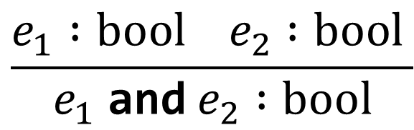
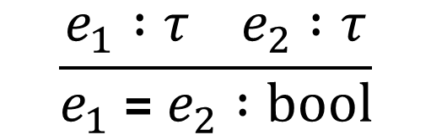

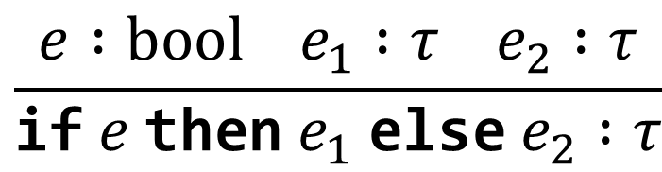
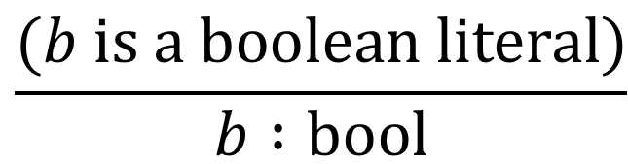
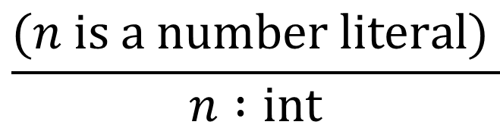
Expressions: Types
Types: int, bool
Rules:
$$\frac{(n is a number literal) }{n :int}$$
$$\frac{e_{1} :int e_{2} :int }{e_{1} \text{+} e_{2} :int}$$
$$\frac{(b is a boolean literal)}{b :bool}$$
$$\frac{e_{1} :bool e_{2} :bool }{e_{1} \text{and} e_{2} :bool}$$
$$\frac{e_{1} :τ e_{2} :τ}{e_{1} \text{=} e_{2} :bool}$$
$$\frac{e :bool e_{1} :τ e_{2} :τ}{\text{if} e \text{then} e_{1} \text{else} e_{2} :τ}$$
Notes:
Let’s step back from implementation, now, and do a bit more design. As we saw in the first interpreter, some expressions have values and others don’t.

Slide 7
Structure of a language
Syntax
  Concrete: what do programs look like?
  Abstract: what are the pieces of a program?
Semantics
  Static: which programs make sense?
  Dynamic: what do programs do when we run them?
Pragmatics
  Implementation: how can we actually make the semantics happen?
  IDE, tool support, etc.
Notes:
We’ll focus mainly on these points: (abstract syntax, semantics, a bit of implementation)

Slide 8

Big-Step Operational Semantics
Describe how expressions compute to values
$e⇓v$ means “expression $e$ evaluates to value $v$”
Roughly the same structure as an interpreter
Defined by a system of inference rules

Slide 9
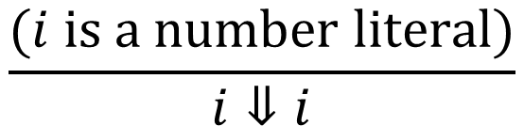
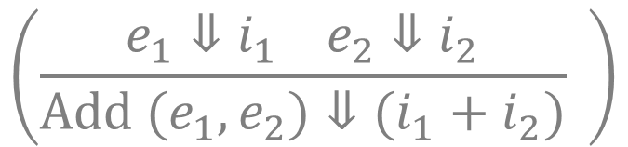
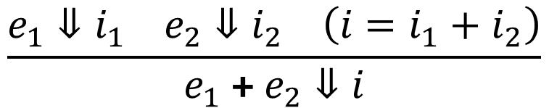
Expressions: Big-Step Semantics
Interpreter
Num i -> IntVal i
Add (e1, e2) -> eval e1 + eval e2
(more or less)
Semantics
$$\frac{(i is a number literal)}{i⇓i}$$
$$\frac{e_{1}⇓i_{1} e_{2}⇓i_{2} \left(i=i_{1}+i_{2}\right)}{e_{1} \text{+}{ e}_{2}⇓i}$$
$$\left(\frac{e_{1}⇓i_{1} e_{2}⇓i_{2}}{Add (e_{1},e_{2})⇓(i_{1}+i_{2})} \right)$$
Notes:
The semantics doesn’t have to handle the “wrong” cases; we can just not give a rule. It also leaves evaluation order unconstrained.

Slide 10
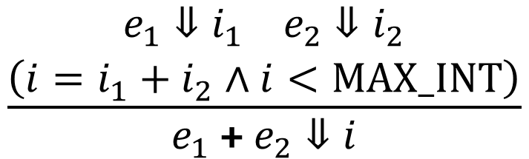
Expressions: Big-Step Semantics
Interpreter
Num i -> IntVal i
Add (e1, e2) -> eval e1 + eval e2
(more or less)
Semantics
to say that addition is only defined when the sum doesn’t overflow
$$\frac{(i is a number literal)}{i⇓i}$$
$$\frac{\begin{aligned}e_{1}⇓i_{1} e_{2}⇓i_{2} \\ \left(i=i_{1}+i_{2}∧i<MAX_INT\right)\end{aligned}}{e_{1} \text{+}{ e}_{2}⇓i}$$
Notes:
The semantics doesn’t have to handle the “wrong” cases; we can just not give a rule. It also leaves evaluation order unconstrained.

Slide 11
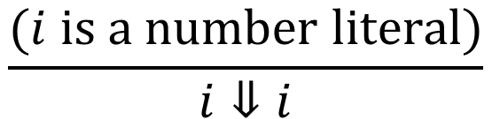

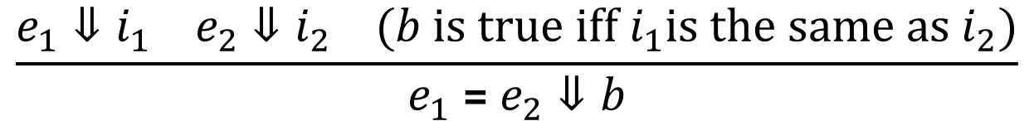
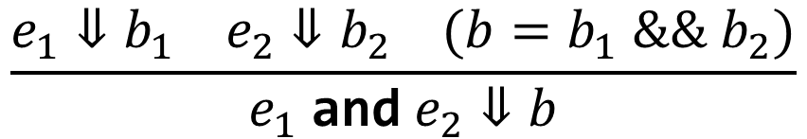
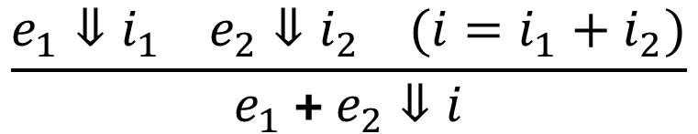
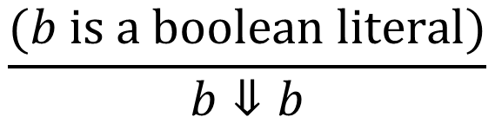
Expressions: Big-Step Semantics
Exercise: Write one or more rules for evaluating if-expressions $\text{if} e \text{then} e_{1} \text{else} e_{2}$.
$$\frac{(i is a number literal)}{i⇓i}$$
$$\frac{e_{1}⇓i_{1} e_{2}⇓i_{2} (i=i_{1}+i_{2})}{e_{1} \text{+} e_{2}⇓i}$$
$$\frac{(b is a boolean literal)}{b⇓b}$$
$$\frac{e_{1}⇓b_{1} e_{2}⇓b_{2} (b=b_{1} \&\& b_{2})}{e_{1} \text{and}{ e}_{2}⇓b}$$
$$\frac{e_{1}⇓i_{1} e_{2}⇓i_{2} (b is true iff i_{1}is the same as i_{2})}{e_{1} \text{=}{ e}_{2}⇓b}$$
Notes:
The Eq rule says we can try to compare ints and bools; to do otherwise we’d need two separate rules.

Slide 12
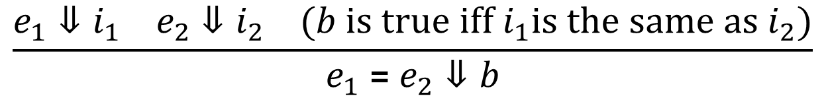
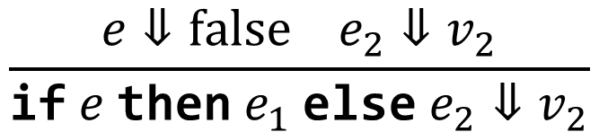
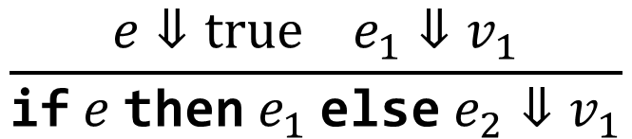
Expressions: Big-Step Semantics
$$\frac{(i is a number literal)}{i⇓i}$$
$$\frac{e_{1}⇓i_{1} e_{2}⇓i_{2} (i=i_{1}+i_{2})}{e_{1} \text{+} e_{2}⇓i}$$
$$\frac{e_{1}⇓i_{1} e_{2}⇓i_{2} (b is true iff i_{1}is the same as i_{2})}{e_{1} \text{=}{ e}_{2}⇓b}$$
$$\frac{e⇓true e_{1}⇓v_{1}}{\text{if} e \text{then} e_{1} \text{else} e_{2}⇓v_{1}}$$
$$\frac{e⇓false e_{2}⇓v_{2}}{\text{if} e \text{then} e_{1} \text{else} e_{2}⇓v_{2}}$$
Notes:
The Eq rule says we can try to compare ints and bools; to do otherwise we’d need two separate rules.

Slide 13
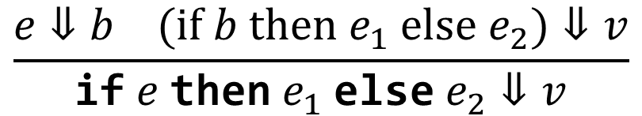
Expressions: Big-Step Semantics
$$\frac{(i is a number literal)}{i⇓i}$$
$$\frac{e_{1}⇓i_{1} e_{2}⇓i_{2} (i=i_{1}+i_{2})}{e_{1} \text{+} e_{2}⇓i}$$
$$\frac{e_{1}⇓i_{1} e_{2}⇓i_{2} (b is true iff i_{1}is the same as i_{2})}{e_{1} \text{=}{ e}_{2}⇓b}$$
$$\frac{e⇓b (if b then e_{1} else e_{2})⇓v}{\text{if} e \text{then} e_{1} \text{else} e_{2}⇓v}$$

Slide 14
Notes:
Poll Title: Do not modify the notes in this section to avoid tampering with the Poll Everywhere activity.
More info at polleverywhere.com/support
Questions
https://www.polleverywhere.com/discourses/SRzwhp4zztmGWgIgz520A

Slide 15
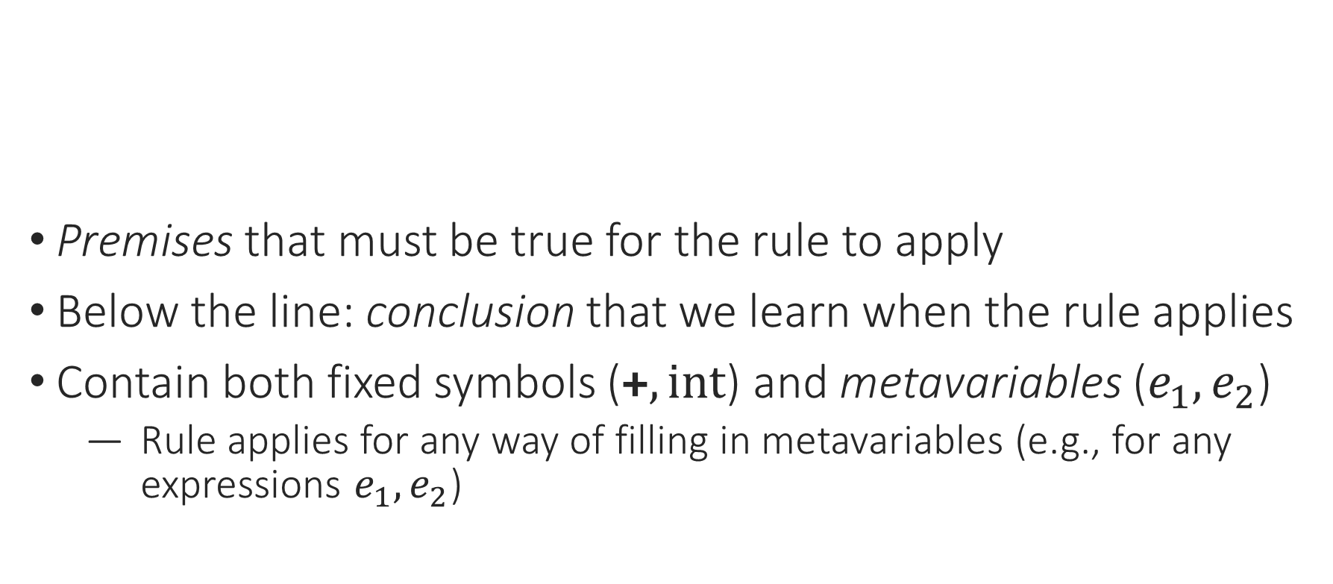
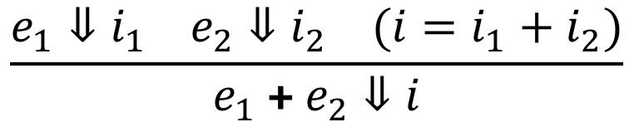

Big-Step Inference Rules
Premises that must be true for the rule to apply
Below the line: conclusion that we learn when the rule applies
Contain both fixed symbols ($\text{+}, int$) and metavariables ($e_{1},e_{2}$)
  Rule applies for any way of filling in metavariables (e.g., for any expressions $e_{1},e_{2}$)
$$\frac{e_{1} :int e_{2} :int }{e_{1} \text{+} e_{2} :int}$$
$$\frac{e_{1}⇓i_{1} e_{2}⇓i_{2} (i=i_{1}+i_{2})}{e_{1} \text{+} e_{2}⇓i}$$
Notes:
Structure of the judgment, bottom-left to top to right, metavariable names imply types, …

Slide 16
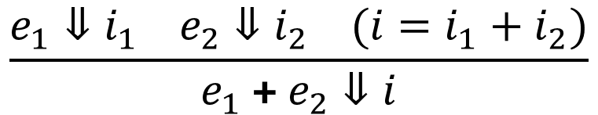
Big-Step Inference Rules
What question are we trying to answer?
  What kind of program does this rule evaluate?
What do we need to know?
  What subexpressions need to be evaluated? What else do we need to compute?
What is the answer?
  What value should the program return?
$$\frac{e_{1}⇓i_{1} e_{2}⇓i_{2} (i=i_{1}+i_{2})}{e_{1} \text{+} e_{2}⇓i}$$
Notes:
Structure of the judgment, bottom-left to top to right, metavariable names imply types, …

Slide 17
Notes:
Poll Title: Do not modify the notes in this section to avoid tampering with the Poll Everywhere activity.
More info at polleverywhere.com/support
Questions
https://www.polleverywhere.com/discourses/SRzwhp4zztmGWgIgz520A

Slide 18
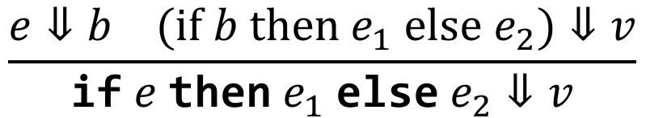
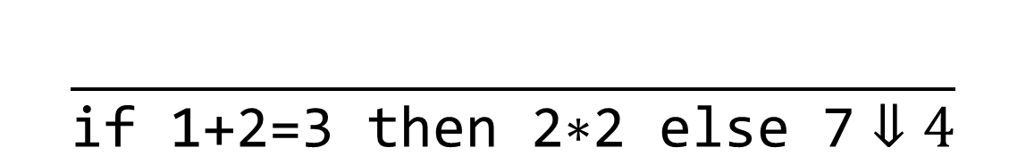
Using the Big-Step Semantics
$$\frac{e⇓b (if b then e_{1} else e_{2})⇓v}{\text{if} e \text{then} e_{1} \text{else} e_{2}⇓v}$$
$$\frac{}{\text{if}\text{ 1+2=3 }\text{then}\text{ 2∗2 }\text{else}\text{ 7}⇓4}$$

Slide 19
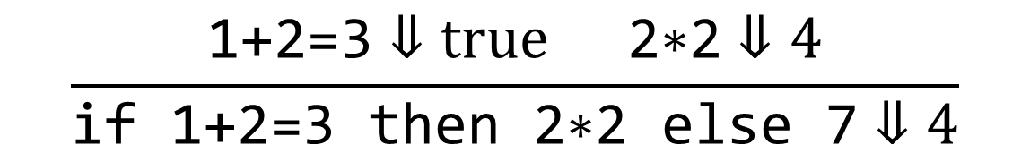
Using the Big-Step Semantics
$$\frac{e⇓b (if b then e_{1} else e_{2})⇓v}{\text{if} e \text{then} e_{1} \text{else} e_{2}⇓v}$$
$$\frac{\text{1+2=3}⇓true \text{2∗2}⇓4}{\text{if}\text{ 1+2=3 }\text{then}\text{ 2∗2 }\text{else}\text{ 7}⇓4}$$

Slide 20
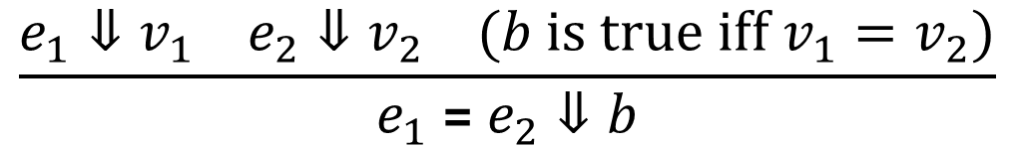
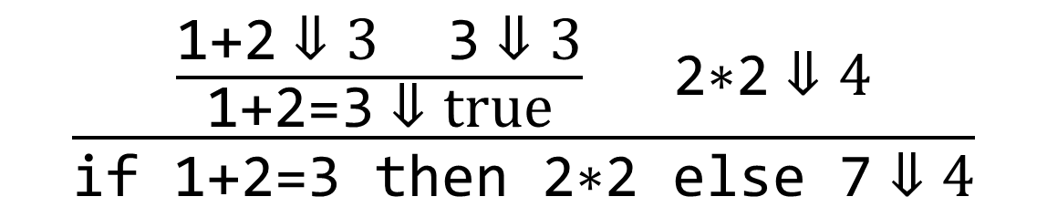
Using the Big-Step Semantics
$$\frac{e_{1}⇓v_{1} e_{2}⇓v_{2} (b is true iff v_{1}=v_{2})}{e_{1} \text{=} e_{2}⇓b}$$
$$\frac{\frac{\text{1+2}⇓3 \text{3}⇓3}{\text{1+2=3}⇓true} \text{2∗2}⇓4}{\text{if}\text{ 1+2=3 }\text{then}\text{ 2∗2 }\text{else}\text{ 7}⇓4}$$

Slide 21
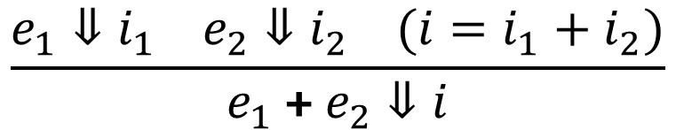
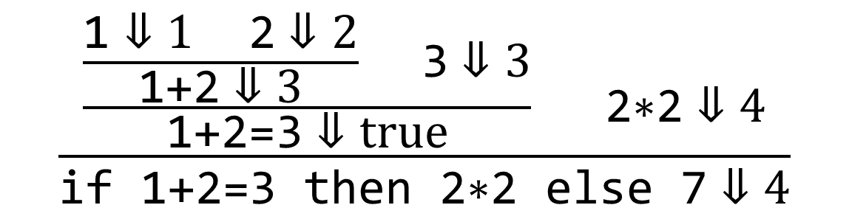
Using the Big-Step Semantics
$$\frac{e_{1}⇓i_{1} e_{2}⇓i_{2} (i=i_{1}+i_{2})}{e_{1} \text{+} e_{2}⇓i}$$
$$\frac{\frac{\frac{\text{1}⇓1 \text{2}⇓2}{\text{1+2}⇓3} \text{3}⇓3}{\text{1+2=3}⇓true} \text{2∗2}⇓4}{\text{if}\text{ 1+2=3 }\text{then}\text{ 2∗2 }\text{else}\text{ 7}⇓4}$$

Slide 22
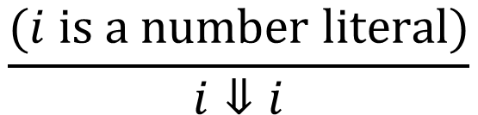
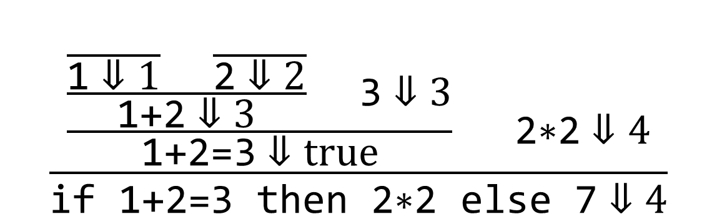
Using the Big-Step Semantics
$$\frac{(i is a number literal)}{i⇓i}$$
$$\frac{\frac{\frac{\frac{}{\text{1}⇓1} \frac{}{\text{2}⇓2}}{\text{1+2}⇓3} \text{3}⇓3}{\text{1+2=3}⇓true} \text{2∗2}⇓4}{\text{if}\text{ 1+2=3 }\text{then}\text{ 2∗2 }\text{else}\text{ 7}⇓4}$$

Slide 23
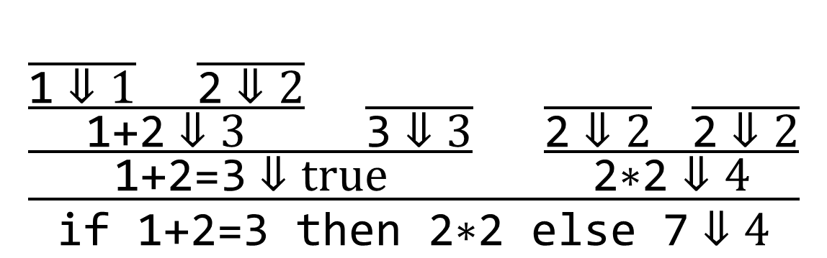
Using the Big-Step Semantics
$$\frac{\frac{\frac{\frac{}{\text{1}⇓1} \frac{}{\text{2}⇓2}}{\text{1+2}⇓3} \frac{}{\text{3}⇓3}}{\text{1+2=3}⇓true} \frac{\frac{}{\text{2}⇓2} \frac{}{\text{2}⇓2}}{\text{2∗2}⇓4}}{\text{if}\text{ 1+2=3 }\text{then}\text{ 2∗2 }\text{else}\text{ 7}⇓4}$$

Slide 24
Notes:
Poll Title: Do not modify the notes in this section to avoid tampering with the Poll Everywhere activity.
More info at polleverywhere.com/support
Questions
https://www.polleverywhere.com/discourses/SRzwhp4zztmGWgIgz520A

Slide 25
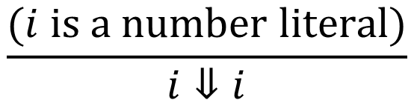
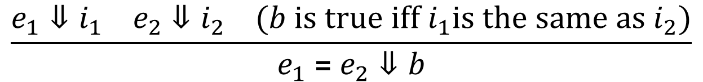
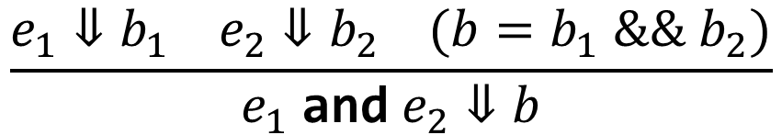
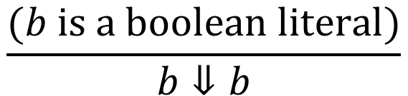
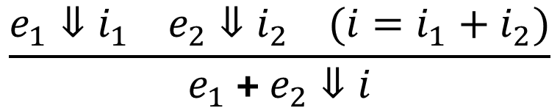
Expressions: Big-Step Semantics
$$\frac{(i is a number literal)}{i⇓i}$$
$$\frac{e_{1}⇓i_{1} e_{2}⇓i_{2} (i=i_{1}+i_{2})}{e_{1} \text{+} e_{2}⇓i}$$
$$\frac{(b is a boolean literal)}{b⇓b}$$
$$\frac{e_{1}⇓b_{1} e_{2}⇓b_{2} (b=b_{1} \&\& b_{2})}{e_{1} \text{and}{ e}_{2}⇓b}$$
$$\frac{e_{1}⇓i_{1} e_{2}⇓i_{2} (b is true iff i_{1}is the same as i_{2})}{e_{1} \text{=}{ e}_{2}⇓b}$$
Notes:
The Eq rule says we can try to compare ints and bools; to do otherwise we’d need two separate rules.

Slide 26
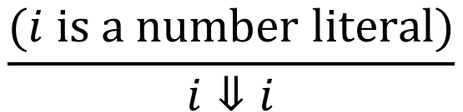
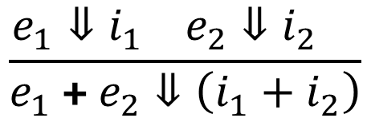
Expressions: Big-Step Semantics
match (e : exp) with
| Num i -> IntVal i
| Add (e1, e2) -> (match eval e1, eval e2 with
| Some (IntVal i1), Some (IntVal i2) ->
Some (IntVal (i1 + i2))
| …)
$$\frac{(i is a number literal)}{i⇓i}$$
$$\frac{e_{1}⇓i_{1} e_{2}⇓i_{2} }{e_{1} \text{+} e_{2}⇓\left(i_{1}+i_{2}\right)}$$

Slide 27
Exercise: Case Expression
Like a 3-way if, or a switch statement in C
case 5 pos: 1 neg: 2 zero: 3 should return 1
case -1 pos: 1 neg: true zero: 3 should return true
case 3–3 pos: 1 neg: 2 zero: 2+3 should return 5
Step 1: Describe its behavior in English.

Slide 28
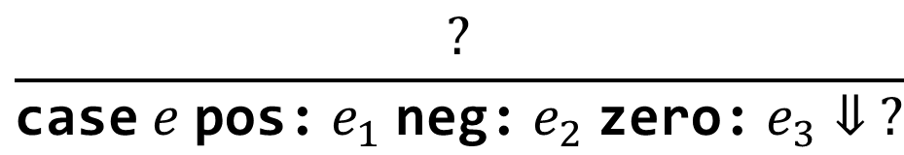
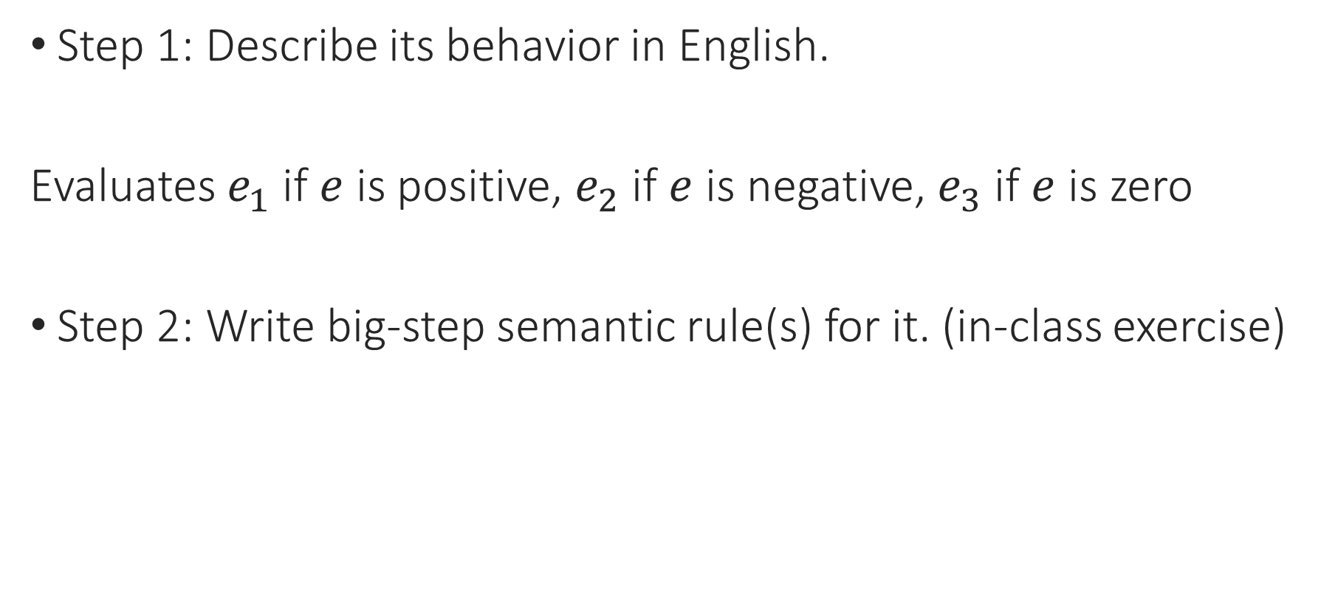
Exercise: Case Expression
Step 1: Describe its behavior in English.
Evaluates $e_{1}$ if $e$ is positive, $e_{2}$ if $e$ is negative, $e_{3}$ if $e$ is zero
Step 2: Write big-step semantic rule(s) for it. (in-class exercise)
$$\frac{?}{\text{case} e \text{pos}\text{:} e_{1} \text{neg}\text{:} e_{2} \text{zero}\text{:} e_{3}⇓ ?}$$

Slide 29
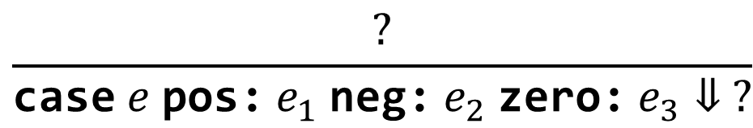
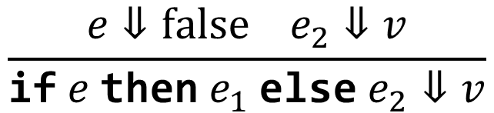
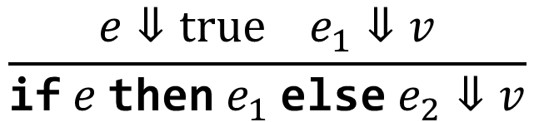
Exercise: Case Expression
Step 2: Write big-step semantic rule(s) for it.
$$\frac{?}{\text{case} e \text{pos}\text{:} e_{1} \text{neg}\text{:} e_{2} \text{zero}\text{:} e_{3}⇓ ?}$$
$$\frac{e⇓true e_{1}⇓v}{\text{if} e \text{then} e_{1} \text{else} e_{2}⇓v}$$
$$\frac{e⇓false e_{2}⇓v}{\text{if} e \text{then} e_{1} \text{else} e_{2}⇓v}$$
Notes:
Which existing construct is most similar?
This is the in-class exercise.

Slide 30
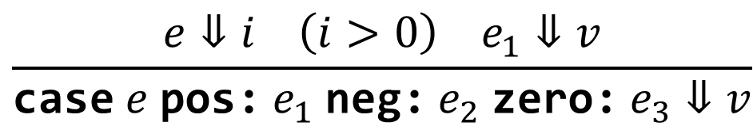
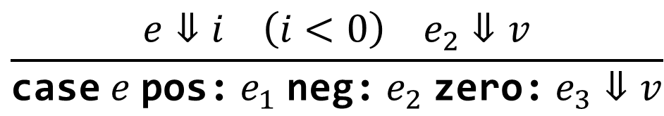
Exercise: Case Expression
Step 2: Write big-step semantic rule(s) for it.
$$\frac{e⇓i \left(i>0\right) e_{1}⇓v}{\text{case} e \text{pos}\text{:} e_{1} \text{neg}\text{:} e_{2} \text{zero}\text{:} e_{3}⇓v}$$
$$\frac{e⇓i \left(i<0\right) e_{2}⇓v}{\text{case} e \text{pos}\text{:} e_{1} \text{neg}\text{:} e_{2} \text{zero}\text{:} e_{3}⇓v}$$
$$\frac{e⇓true e_{1}⇓v}{\text{if} e \text{then} e_{1} \text{else} e_{2}⇓v}$$
$$\frac{e⇓false e_{2}⇓v}{\text{if} e \text{then} e_{1} \text{else} e_{2}⇓v}$$
Notes:
Which existing construct is most similar?
We have to evaluate e before we know whether it’s greater or less than 0 – otherwise, it’s a whole program.

Slide 31
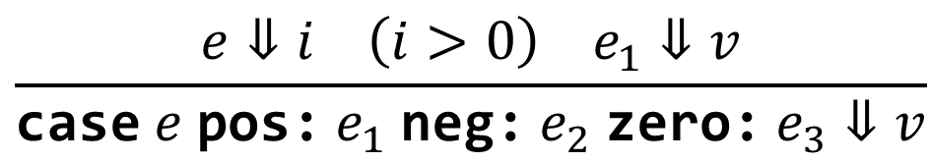


Exercise: Case Expression
Step 2: Write big-step semantic rule(s) for it.
$$\frac{e⇓i \left(i>0\right) e_{1}⇓v}{\text{case} e \text{pos}\text{:} e_{1} \text{neg}\text{:} e_{2} \text{zero}\text{:} e_{3}⇓v}$$
$$\frac{e⇓i \left(i<0\right) e_{2}⇓v}{\text{case} e \text{pos}\text{:} e_{1} \text{neg}\text{:} e_{2} \text{zero}\text{:} e_{3}⇓v}$$
$$\frac{e⇓0 e_{3}⇓v}{\text{case} e \text{pos}\text{:} e_{1} \text{neg}\text{:} e_{2} \text{zero}\text{:} e_{3}⇓v}$$
Notes:
Note that we don’t need to evaluate 0.

Slide 32

Exercise: Case Expression
Step 3: Implement it in the interpreter.
let rec eval (e : exp) : value option =
match e with
| Case (cond, e1, e2, e3) -> (match eval cond with …)
$$\frac{e⇓i \left(i>0\right) e_{1}⇓v}{\text{case} e \text{pos}\text{:} e_{1} \text{neg}\text{:} e_{2} \text{zero}\text{:} e_{3}⇓v} …$$

Slide 33
Exercise: Case Expression
Step 3: Implement it in the interpreter.
let rec eval (e : exp) : value option =
match e with
| Case (cond, e1, e2, e3) ->
(match eval cond with
| Some (IntVal i) -> if i > 0 then eval e1
else if i < 0 then eval e2 else eval e3
| _ -> None)

Slide 34
Exercise: Case Expression
Step 4: Run test cases.
let rec eval (e : exp) : value option = …
eval (Case (Num 5, Num 1, Num 2, Num 3));;
(* should return Some (IntVal 1)) *)

Slide 35
Notes:
Poll Title: Do not modify the notes in this section to avoid tampering with the Poll Everywhere activity.
More info at polleverywhere.com/support
Questions
https://www.polleverywhere.com/discourses/SRzwhp4zztmGWgIgz520A

